Slide 2
Object detection is an advanced form of image classification where a neural network predicts objects in an image and points them out in the form of bounding boxes.
Object detection thus refers to the detection and localization of objects in an image that belong to a predefined set of classes.
Tasks like detection, recognition, or localization find widespread applicability in real-world scenarios, making object detection (also referred to as object recognition) a very important subdomain of Computer Vision.

Slide 3
Two-stage object detection
Two-stage object detection refers to the use of algorithms that break down the object detection problem statement into the following two-stages:
Detecting possible object regions.
Classifying the image in those regions into object classes.
Popular two-step algorithms like Fast-RCNN and Faster-RCNN typically use a Region Proposal Network that proposes regions of interest that might contain objects.

Slide 4
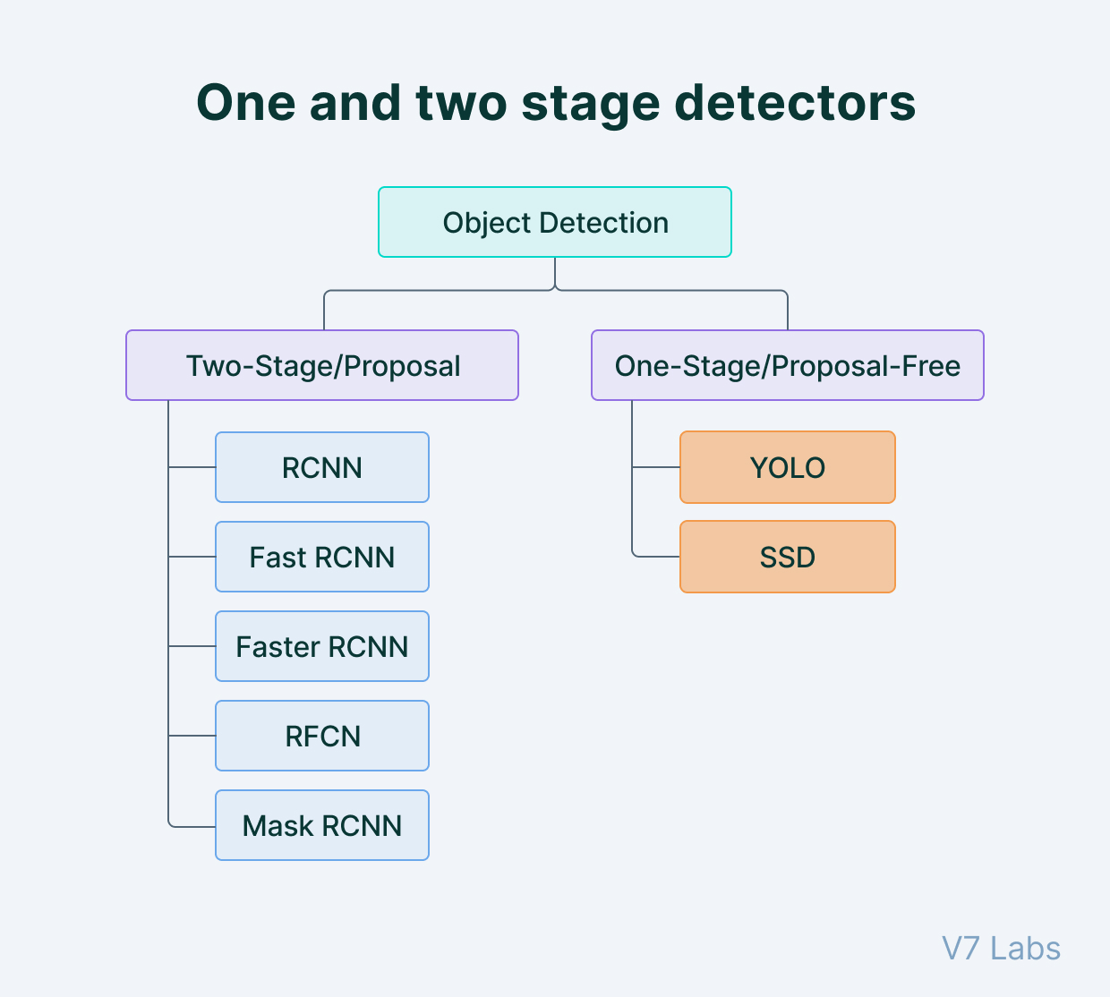
The output from the RPN is then fed to a classifier that classifies the regions into classes.
While this gives accurate results in object detection with a high mean Average Precision (mAP), it results in multiple iterations taking place in the same image, thus slowing down the detection speed of the algorithm and preventing real-time detection.

Slide 5
What is YOLO?
Compared to the approach taken by object detection algorithms before YOLO, which repurpose classifiers to perform detection, YOLO proposes the use of an end-to-end neural network that makes predictions of bounding boxes and class probabilities all at once.
Following a fundamentally different approach to object detection, YOLO achieves state-of-the-art results beating other real-time object detection algorithms by a large margin.

Slide 6
YOLO vs. other detectors
In addition to increased accuracy in predictions and a better Intersection over Union in bounding boxes (compared to real-time object detectors), YOLO has the inherent advantage of speed.
YOLO is a much faster algorithm than its counterparts, running at as high as 45 FPS.
While algorithms like Faster RCNN work by detecting possible regions of interest using the Region Proposal Network and then perform recognition on those regions separately, YOLO performs all of its predictions with the help of a single fully connected layer.
Methods that use Region Proposal Networks thus end up performing multiple iterations for the same image, while YOLO gets away with a single iteration.

Slide 7
YOLO limitations
Although YOLO does seem to be the best algorithm to use if you have an object detection problem to solve, it comes with several limitations.
YOLO struggles to detect and segregate small objects in images that appear in groups, as each grid is constrained to detect only a single object. Small objects that naturally come in groups, such as a line of ants, are therefore hard for YOLO to detect and localize.
YOLO is also characterized by lower accuracy when compared to much slower object detection algorithms like Fast RCNN.
Now, before we deep dive into more details about the YOLO architecture and methodology, let's go over some of the important terminology.

Slide 8
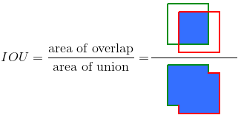
Intersection over Union (IoU)
Intersection over Union is a popular metric to measure localization accuracy and calculate localization errors in object detection models.
To calculate the IoU with the predictions and the ground truth, we first take the intersecting area between the bounding boxes for a particular prediction and the ground truth bounding boxes of the same area. Following this, we calculate the total area covered by the two bounding boxes—also known as the Union.
The intersection divided by the Union, gives us the ratio of the overlap to the total area, providing a good estimate of how close the bounding box is to the original prediction.

Slide 9
Average Precision (AP)
Average Precision is calculated as the area under a precision vs recall curve for a set of predictions.
Recall is calculated as the ratio of the total predictions made by the model under a class with a total of existing labels for the class.
On the other hand, Precision refers to the ratio of true positives with respect to the total predictions made by the model.
The area under the precision vs recall curve gives us the Average Precision per class for the model. The average of this value, taken over all classes, is termed as mean Average Precision (mAP).
💡 Note: In object detection, precision and recall are not for class predictions, but for predictions of boundary boxes for measuring the decision performance. An IoU value > 0.5. is taken as a positive prediction, while an IoU value < 0.5 is a negative prediction.

Slide 10
Algorithms based on regression
Instead of selecting interesting parts of an image, they predict classes and bounding boxes for the whole image in one run of the algorithm. The two best-known examples from this group are the YOLO (You Only Look Once) family algorithms and SSD (Single Shot Multibox Detector). They are commonly used for real-time object detection as, in general, they trade a bit of accuracy for large improvements in speed.

Slide 11
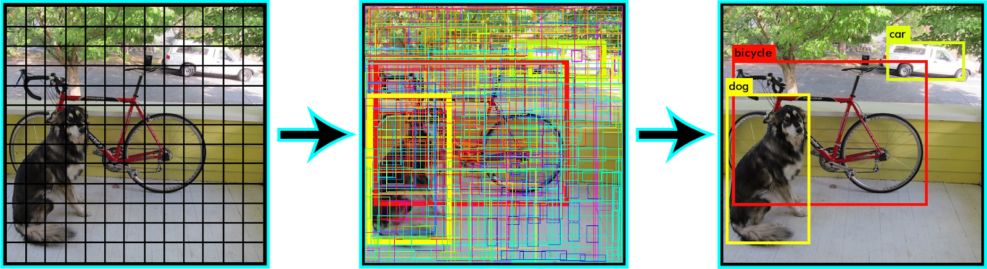
How does YOLO work?
The YOLO algorithm works by dividing the image into N grids, each having an equal dimensional region of SxS. Each of these N grids is responsible for the detection and localization of the object it contains.
Correspondingly, these grids predict B bounding box coordinates relative to their cell coordinates, along with the object label and probability of the object being present in the cell.
This process greatly lowers the computation as both detection and recognition are handled by cells from the image, but—
It brings forth a lot of duplicate predictions due to multiple cells predicting the same object with different bounding box predictions.
YOLO makes use of Non Maximal Suppression to deal with this issue.

Slide 12
How does YOLO work?
In Non Maximal Suppression, YOLO suppresses all bounding boxes that have lower probability scores.
YOLO achieves this by first looking at the probability scores associated with each decision and taking the largest one. Following this, it suppresses the bounding boxes having the largest Intersection over Union with the current high probability bounding box.
This step is repeated till the final bounding boxes are obtained.

Slide 13
Understanding YOLO object detection: the YOLO algorithm
To understand the YOLO algorithm, it is necessary to establish what is actually being predicted. Ultimately, we aim to predict a class of an object and the bounding box specifying object location. Each bounding box can be described using four descriptors:
center of a bounding box (bxby)
width (bw)
height (bh)
value cis corresponding to a class of an object (e.g., car, traffic lights, etc.)

Slide 14
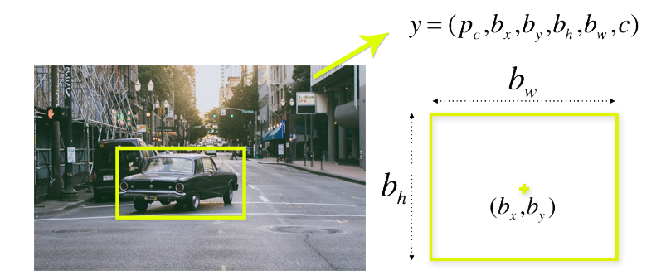
n addition, we have to predict the pc value, which is the probability that there is an object in the bounding box.

Slide 15
As we mentioned above, when working with the YOLO algorithm we are not searching for interesting regions in our image that could potentially contain an object.
Instead, we are splitting our image into cells, typically using a 19×19 grid. Each cell is responsible for predicting 5 bounding boxes (in case there is more than one object in this cell). Therefore, we arrive at a large number of 1805 bounding boxes for one image. Rather than seizing the day with #YOLO and Carpe Diem, we’re looking to seize object probability. The exchange of accuracy for more speed isn’t reckless behavior, but a necessary requirement for faster real-time object detection.

Slide 16
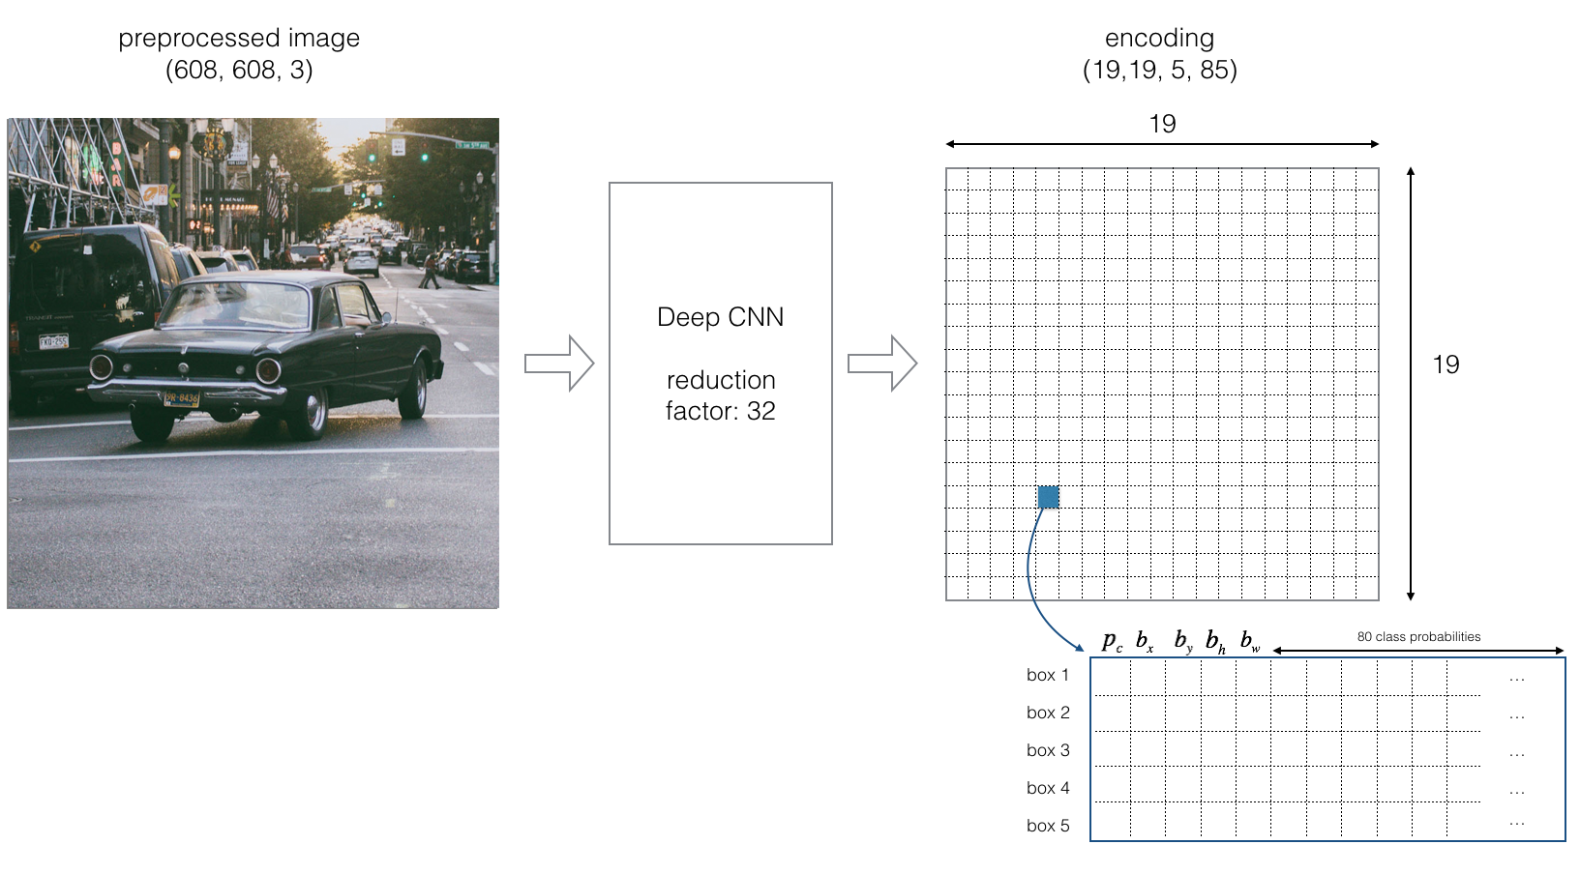

Slide 17
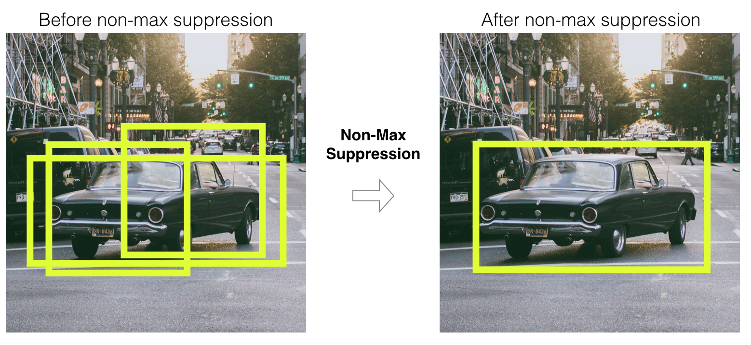
Most of these cells and bounding boxes will not contain an object. Therefore, we predict the value pc, which serves to remove boxes with low object probability and bounding boxes with the highest shared area in a process called non-max suppression.

Slide 18
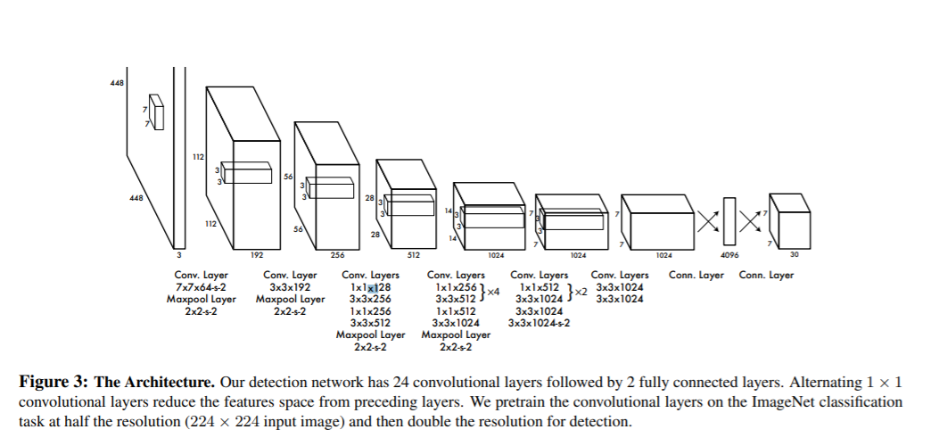
YOLO Architecture
Inspired by the GoogleNet architecture, YOLO’s architecture has a total of 24 convolutional layers with 2 fully connected layers at the end.

Slide 19
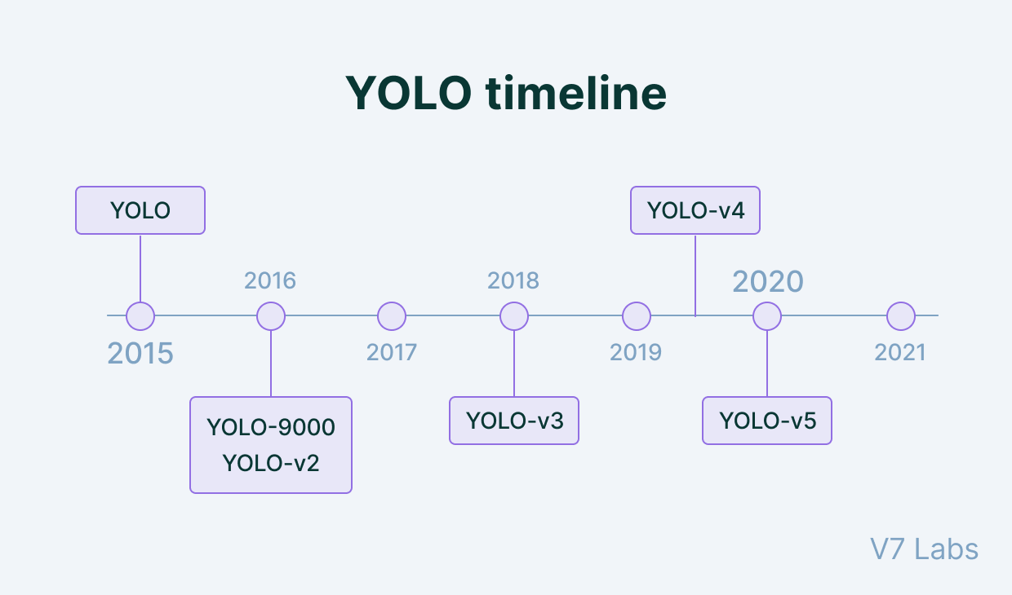
Here's a timeline showcasing YOLO's development in recent years.

Slide 20
YOLOv1
The first YOLO version was announced in 2015 by Joseph Redmon, Santosh Divvala, Ross Girshick, and Ali Farhadi in the article “You Only Look Once: Unified, Real-Time Object Detection”. Not long after, YOLO dominated the object-detection field and became the most popular algorithm used, because of its speed, accuracy, and learning ability.
Instead of treating object detection as a classification problem, the authors thought about it as a regression task concerning spatially separated bounding boxes and associated class probabilities, using a single neural network. The YOLOv1 processed images in real-time at 45 frames per second, while a smaller version – Fast YOLO – reached 155 frames per second and still achieved double the mAP of other real-time detectors.

Slide 21
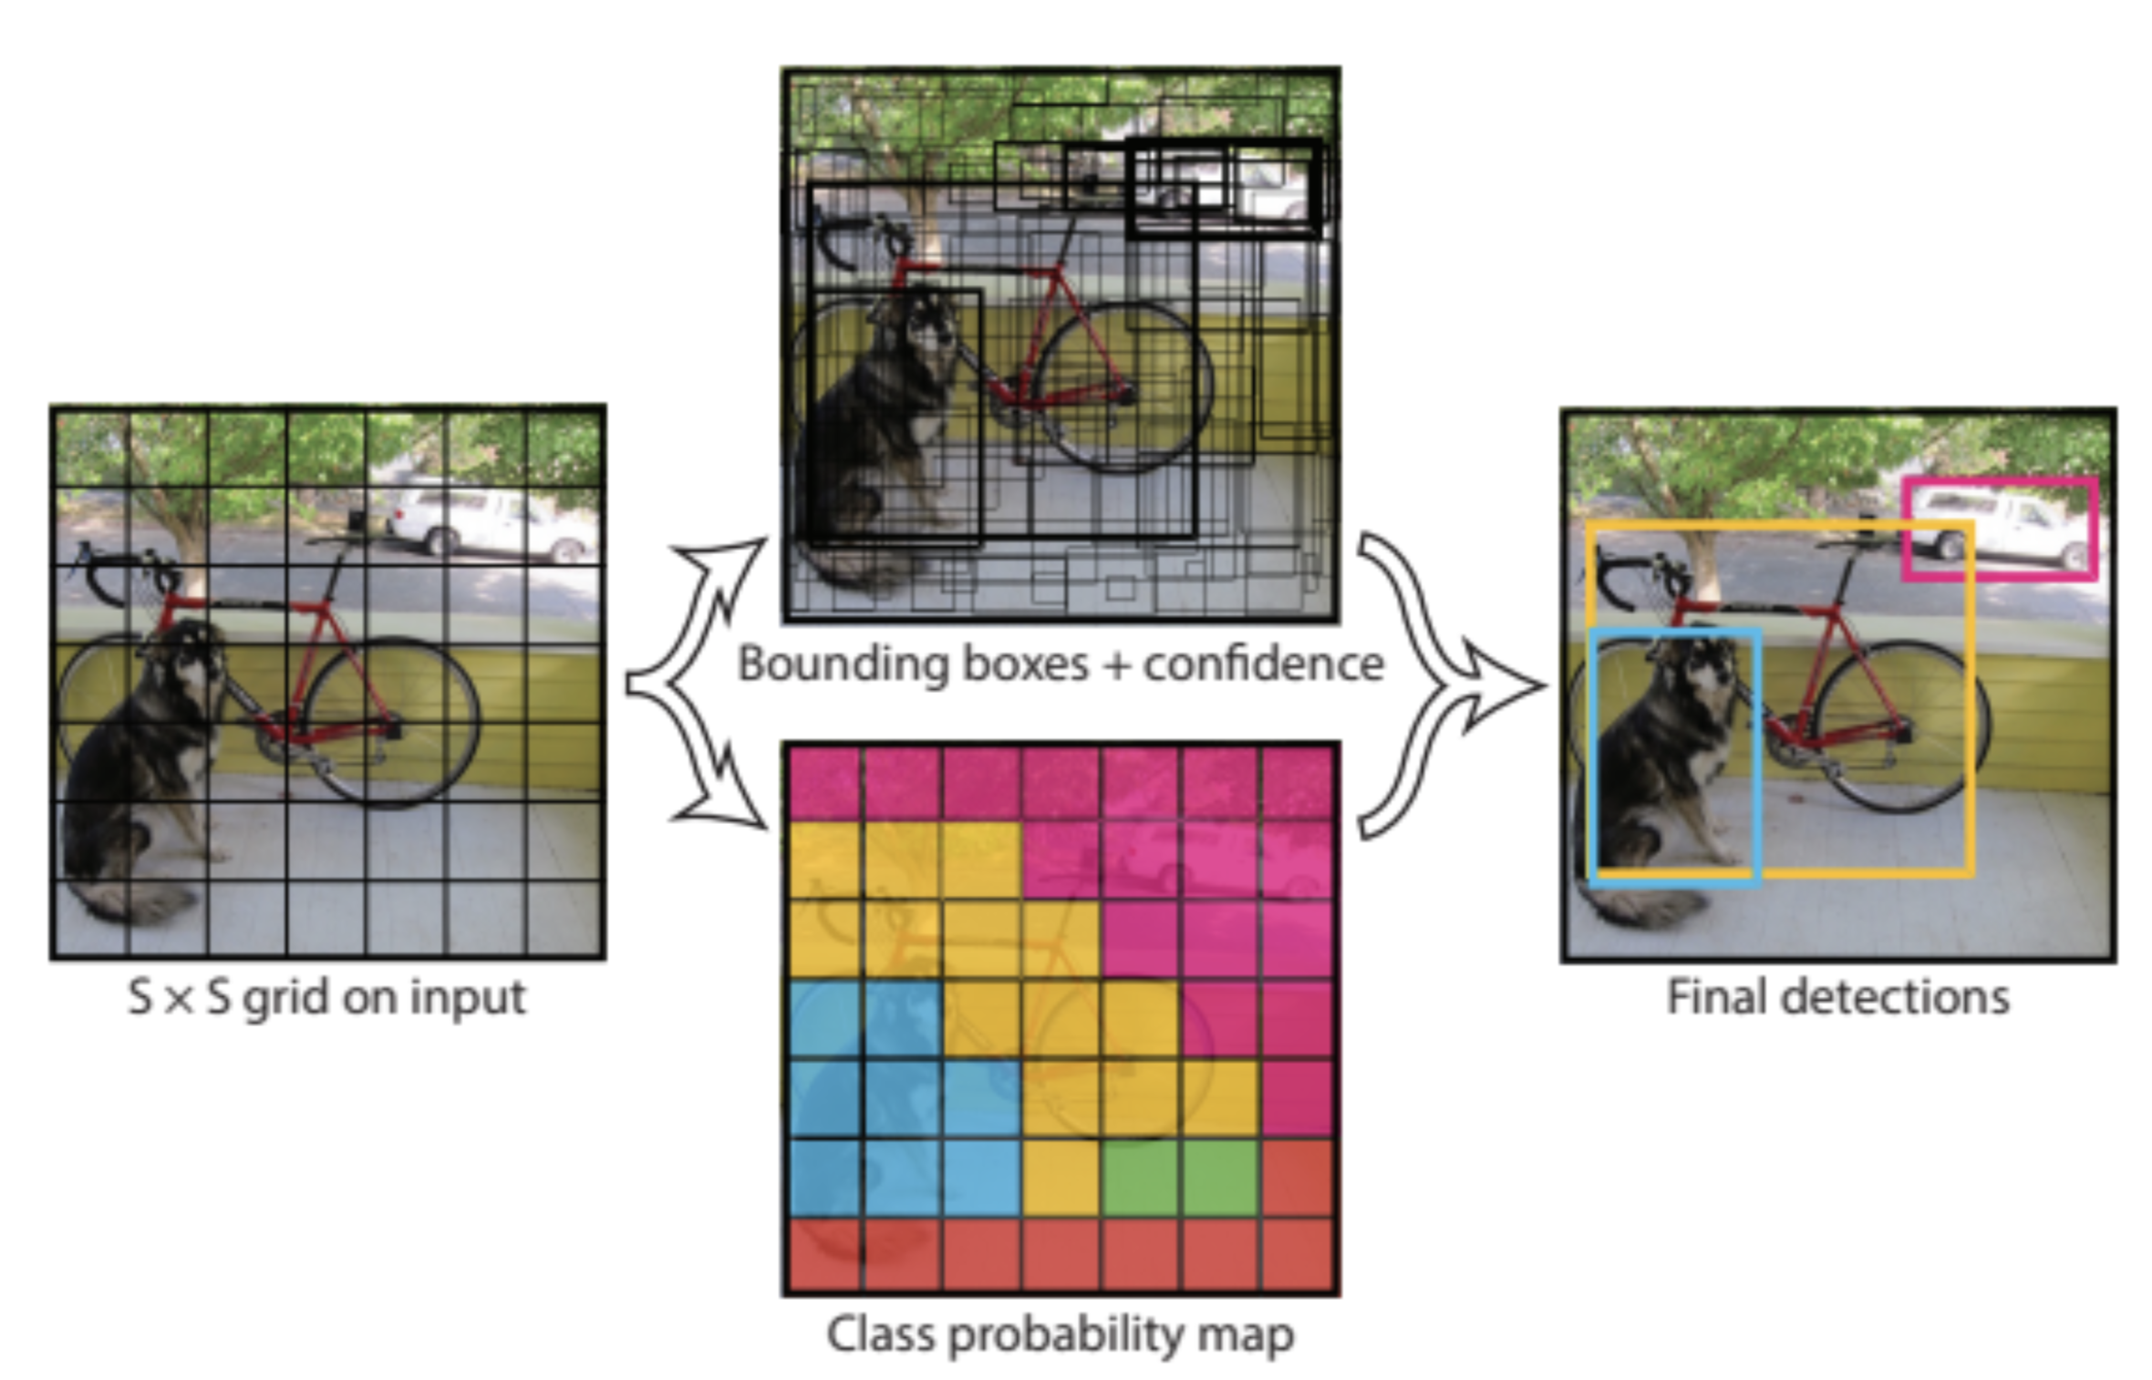
YOLOV1 algorithm

Slide 22
YOLOv2
YOLOv2 (sometimes called YOLO9000), was released a year later, in 2016 also by Joseph Redmon and Ali Farhadi in the article “YOLO9000: Better, Faster, Stronger”. The name with number 9000 was given, because of the model’s ability to predict even 9000 different objects categories and still run in real-time. The novel model version was not only trained simultaneously on object detection and classification datasets but also gained Darknet-19 as the new baseline model.
Since YOLOv2 was also a huge success and became the next state-of-the-art object detection model, more and more engineers began to experiment with this algorithm and create their own, diverse YOLO versions. Some of them will be mentioned throughout the article.

Slide 23
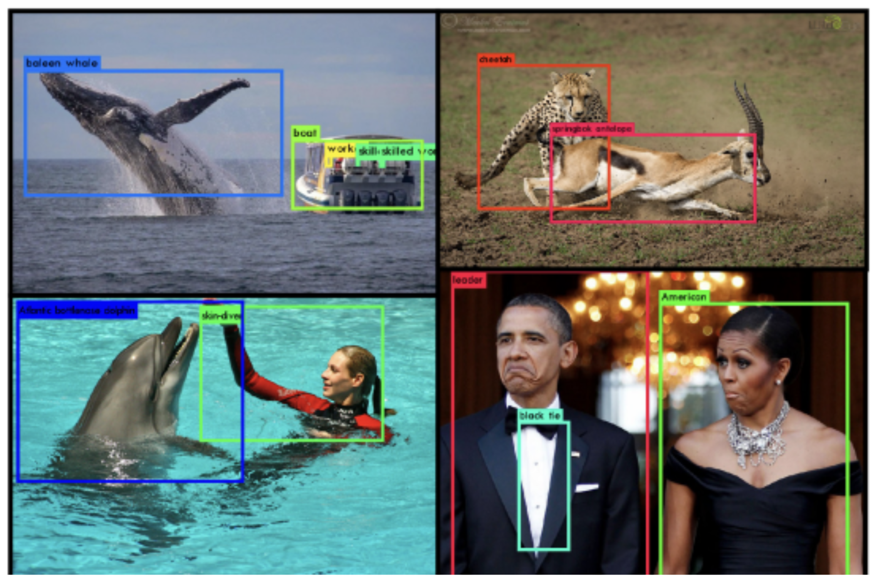
YOLOv2 detection examples with a wide variety of categories

Slide 24
The differences: YOLO, YOLOv2, YOLO9000, YOLOv3, YOLOv4+
YOLOv2
YOLOv2 was proposed to fix YOLO’s main issues—the detection of small objects in groups and the localization accuracy.
YOLOv2 increases the mean Average Precision of the network by introducing batch normalization.
Batch Norm increases the mAP value by as much as 2 percent.
A much more impactful addition to the YOLO algorithm, as proposed by YOLOv2, was the addition of anchor boxes. YOLO, as we know, predicts a single object per grid cell. While this makes the built model simpler, it creates issues when a single cell has more than one object, as YOLO can only assign a single class to the cell.
YOLOv2 gets rid of this limitation by allowing the prediction of multiple bounding boxes from a single cell. This is achieved by making the network predict 5 bounding boxes for each cell.
The number 5 is empirically derived as having a good trade-off between model complexity and prediction performance. DarkNet-19 containing a total of 19 convolutional layers and 5 max-pooling layers is used as the backbone for the YOLOv2 architecture.

Slide 25
YOLO9000
Using a similar network architecture as YOLOv2, YOLO9000 was proposed as an algorithm to detect more classes than COCO as an object detection dataset could have made possible.
The object detection dataset that these models were trained on (COCO) has only 80 classes as compared to classification networks like ImageNet which has 22.000 classes.
To enable the detection of many more classes, YOLO9000 makes use of labels from both ImageNet and COCO, effectively merging the image classification and detection tasks to only perform detection.
Since some classes of COCO can be referred to as superset classes of some classes of ImageNet, YOLO9000 makes use of a hierarchical classification-based algorithm inspired by WordNet, where classes and their subclasses are represented in a tree-based fashion.
While YOLO9000 provides a lower mean Average Precision as compared to YOLOv2, it is capable of detecting more than 9000 classes, making it a powerful algorithm.

Slide 26
YOLOv3
While YOLOv2 is a superfast network, various alternatives that offer better accuracies—like Single Shot Detectors—have also entered the scene. Although much slower, they outstrip YOLOv2 and YOLO9000 in terms of accuracy.
To improve YOLO with modern CNNs that make use of residual networks and skip connections, YOLOv3 was proposed.

Slide 27
While YOLOv2 uses the DarkNet-19 as the model architecture, YOLOv3 uses a much more complex DarkNet-53 as the model backbone— a 106 layer neural network complete with residual blocks and upsampling networks.
YOLOv3’s architectural novelty allows it to predict at 3 different scales, with the feature maps being extracted at layers 82, 94, and 106 for these predictions..
By detecting features at 3 different scales, YOLOv3 makes up for the shortcomings of YOLOv2 and YOLO, particularly in the detection of smaller objects. With the architecture allowing the concatenation of the upsampled layer outputs with the features from previous layers, the fine-grained features that have been extracted are preserved thus making the detection of smaller objects easier.
YOLOv3 only predicts 3 bounding boxes per cell (compared to 5 in YOLOv2) but it makes three predictions at different scales, totaling up to 9 anchor boxes.

Slide 28
YOLOv4
The fourth version of the YOLO algorithm was released in April 2020 by Alexey Bochkovskiy, Chien-Yao Wang, and Hong-Yuan Mark Liao in their article “YOLOv4: Optimal Speed and Accuracy of Object Detection”. It was based on the SPDarknet53 architecture and introduced a fair amount of new concepts, such as Weighted Residual Connections, Cross-Stage-Partial connections, cross mini-batch normalization, self-adversarial training, mish activation, dropblock, and CIoU loss.
YOLOv4 is the continuation of the YOLO family but was created by different scientists (not Joseph Redmon and Ali Farhadi). Its architecture consists of SPDarknet53 backbone, spatial pyramid pooling, PANet path-aggregation as neck, and YOLOv3 head.
As a result, YOLOv4 reaches 10% higher Average Precision and 12% better Frames Per Second metrics, compared to its ancestor, YOLOv3.

Slide 29
YOLOv4 proposes the addition of Weighted Residual Connections, Cross Mini Batch Normalization, Cross Stage Partial Connections, Self Adversarial Training, and Mish Activation as methodological changes amongst modern methods of regularization and data augmentation. The authors also make available a YOLOv4 Tiny version that provides faster object detection and a higher FPS while making a compromise in the prediction accuracy.
YOLOv5 is an open-source project that consists of a family of object detection models and detection methods based on the YOLO model pre-trained on the COCO dataset. It is maintained by Ultralytics and represents the organization’s open-source research into the future of Computer Vision works.

Slide 30
YOLOv5
The fifth iteration of the most popular object detection algorithm was released shortly after YOLOv4, but this time by Glenn Jocher. First time ever, YOLO used the PyTorch deep learning framework, which aroused a lot of controversy among the users.
The official article couldn’t be announced, because YOLOv5 does not implement or invent any novel techniques. It is just the PyTorch extension of YOLOv3. Such a situation was used by Ultranytics company and spread the word about the “new YOLO” version under its patronage. The fact is, that the YOLOv5 webpage is very clear and nicely built and written, with a lot of tutorials and tips on training and using the YOLOv5 models because there are also five pre-trained models available, ready for use.

Slide 31
YOLACT (You Only Look At Coefficients) proposed by Bolya is an application of the YOLO principle for real-time instance segmentation.
In other words, YOLACT proposes an end-to-end convolutional network for instance segmentation that achieves 29.8 mean Average Precision at 33.5 FPS on a single Titan Xp, which is significantly faster than other instance segmentation algorithms.
YOLACT performs instance segmentation by generating a set of prototype masks and per-instance mask coefficients. A linear combination of the two steps is performed to generate the final instance masks.

Slide 32
YOLO fast object detection and classification – how does it work?
Traditional methods of detecting objects most often divide the entire process into several stages.
For example, Faster R-CNN first uses a convolutional neural network to extract the desired features of the image (the so-called feature extraction).
Then the output in the form of the feature map is an input to another neural network, the task of which is to suggest image regions where objects may be located. Such a network is called Region Proposal Network (RPN) and it is both a classifier (indicating the probability that a given region contains an object) and a regression model (describing a region of an image containing a potential object).
The output of the RPN is passed to the third neural network, whose task is to predict classes of objects and bounding boxes. As you can see, it is quite a complicated, multi-stage process, that has to take quite a long time, at least compared to YOLO.

Slide 33
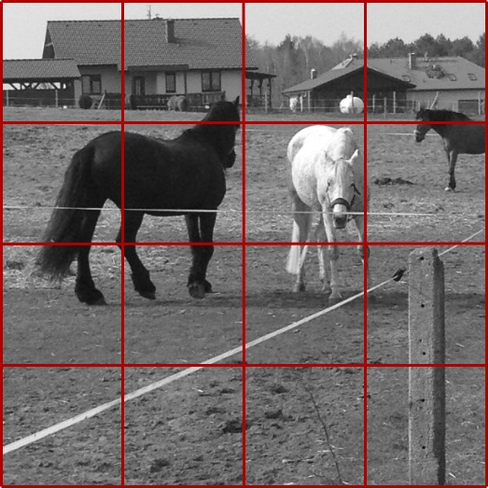
YOLO takes a completely different approach. First of all, it treats the detection and classification problems as a single regression problem. It does not divide the analysis into stages. Instead, a single convolutional neural network simultaneously predicts multiple bounding boxes and determines the class probabilities for each of the areas in which the object has been detected.
In the first step, YOLO puts a grid with the size of S x S on the image. For example, for S = 4, we get 16 cells, as in the image below.

Slide 34
For each cell YOLO predicts B objects. B is usually a small number, like 2. This means that we assume that in each cell YOLO will identify at most 2 objects. Of course, there may be more objects overlapping in the image. But when there are 3 or more overlapping objects in a given cell, they become very difficult to identify – especially when we consider the fact that S is usually greater than the one we used in our example (4), and therefore the applied grid has a higher granulation.
Thus, for each cell of the grid, YOLO predicts whether there are objects in it and for each of them the coordinates of the rectangle surrounding the object are determined (bounding box). This means that in the output vector we need to predict a place for B * 5 values. Why 5? This is because a bounding box is defined with 4 values: two coordinates of the center of the object (relative to the coordinates of the analyzed cell) and the width and height of the rectangle (as a fraction of the image size). In addition, there is a fifth value that logically determines whether or not there is an object in a given cell.
Finally, the class probabilities should be added to the output vector – for each object separately. For example, if we are going to predict C = 10 classes for a maximum of B = 2 objects in one grid cell, then the final output tensor will be: S x S x (B * (5 + C)). In our example: 4 x 4 x (2 * (5 + 10)) = 4 x 4 x 30.
So, we train the network and make predictions assuming a tensor on the output – hence it is easy to understand why the problem of object identification and classification was reduced by YOLO to the regression problem.

Slide 35
Two important points that may have caught your attention:
If the algorithm identifies an object in a grid cell, is the bounding box somehow related to the grid cell? Yes and no. Yes, because this cell includes the center of the bounding box. No, because of course the actual surrounding rectangle will hardly ever coincide with the boundaries of the grid cell.
Because the grid has the same number of rows and columns, the analyzed images must be square and have the size appropriate to the given YOLO implementation. If images are rectangular or do not correspond to the size expected by the network, many YOLO implementations resize the input images and transform them to aspect ratio = 1 (e.g. replenishing images with black padding).

Slide 36
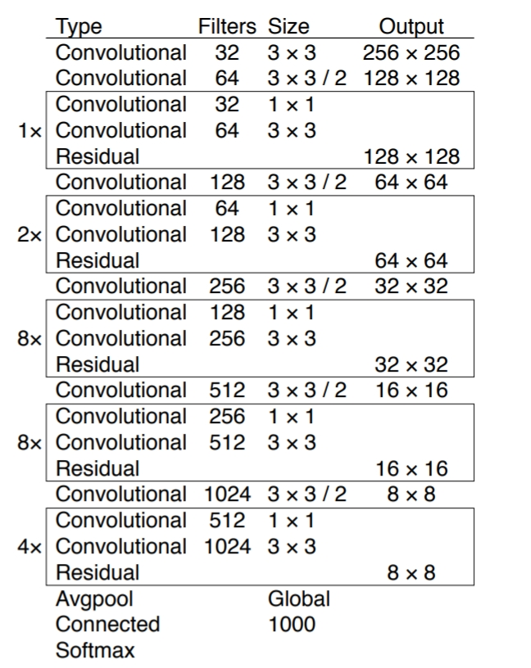
YOLO – the architecture

Slide 37
In the third version of the algorithm, the authors used the pretty extensive convolutional neural network with the architecture presented below. BTW: if you want to explore convolutional neural networks from scratch, there is a four-part tutorial on my blog.
The network has 53 convolutional layers, hence it was called Darknet-53.

Slide 38
YOLO Algorithm and YOLO Object Detection - Machine Learning (appsilon.com)

